Slide 1
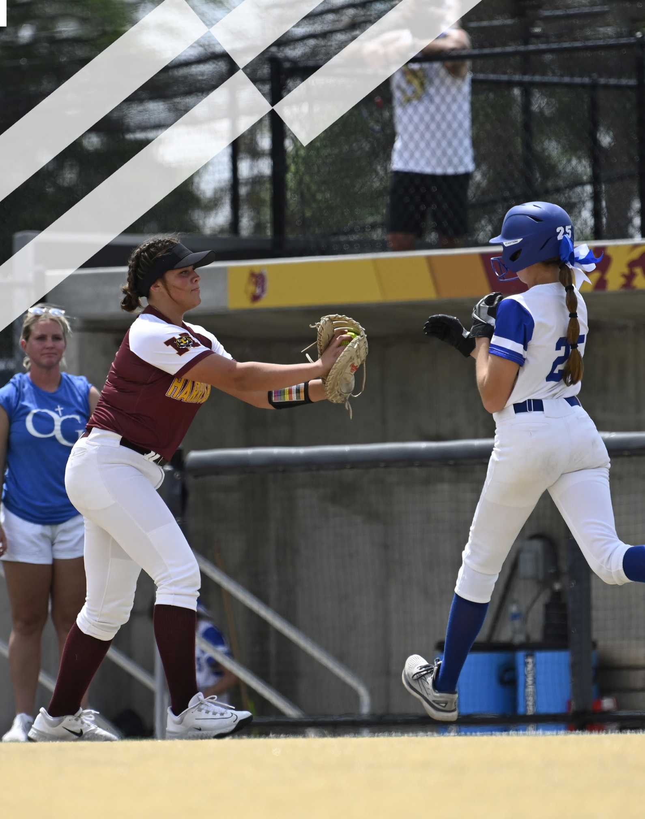
2026 NFHS Softball Rules PowerPoint
Rule Changes
Editorial Changes
Points of Emphasis

Slide 2
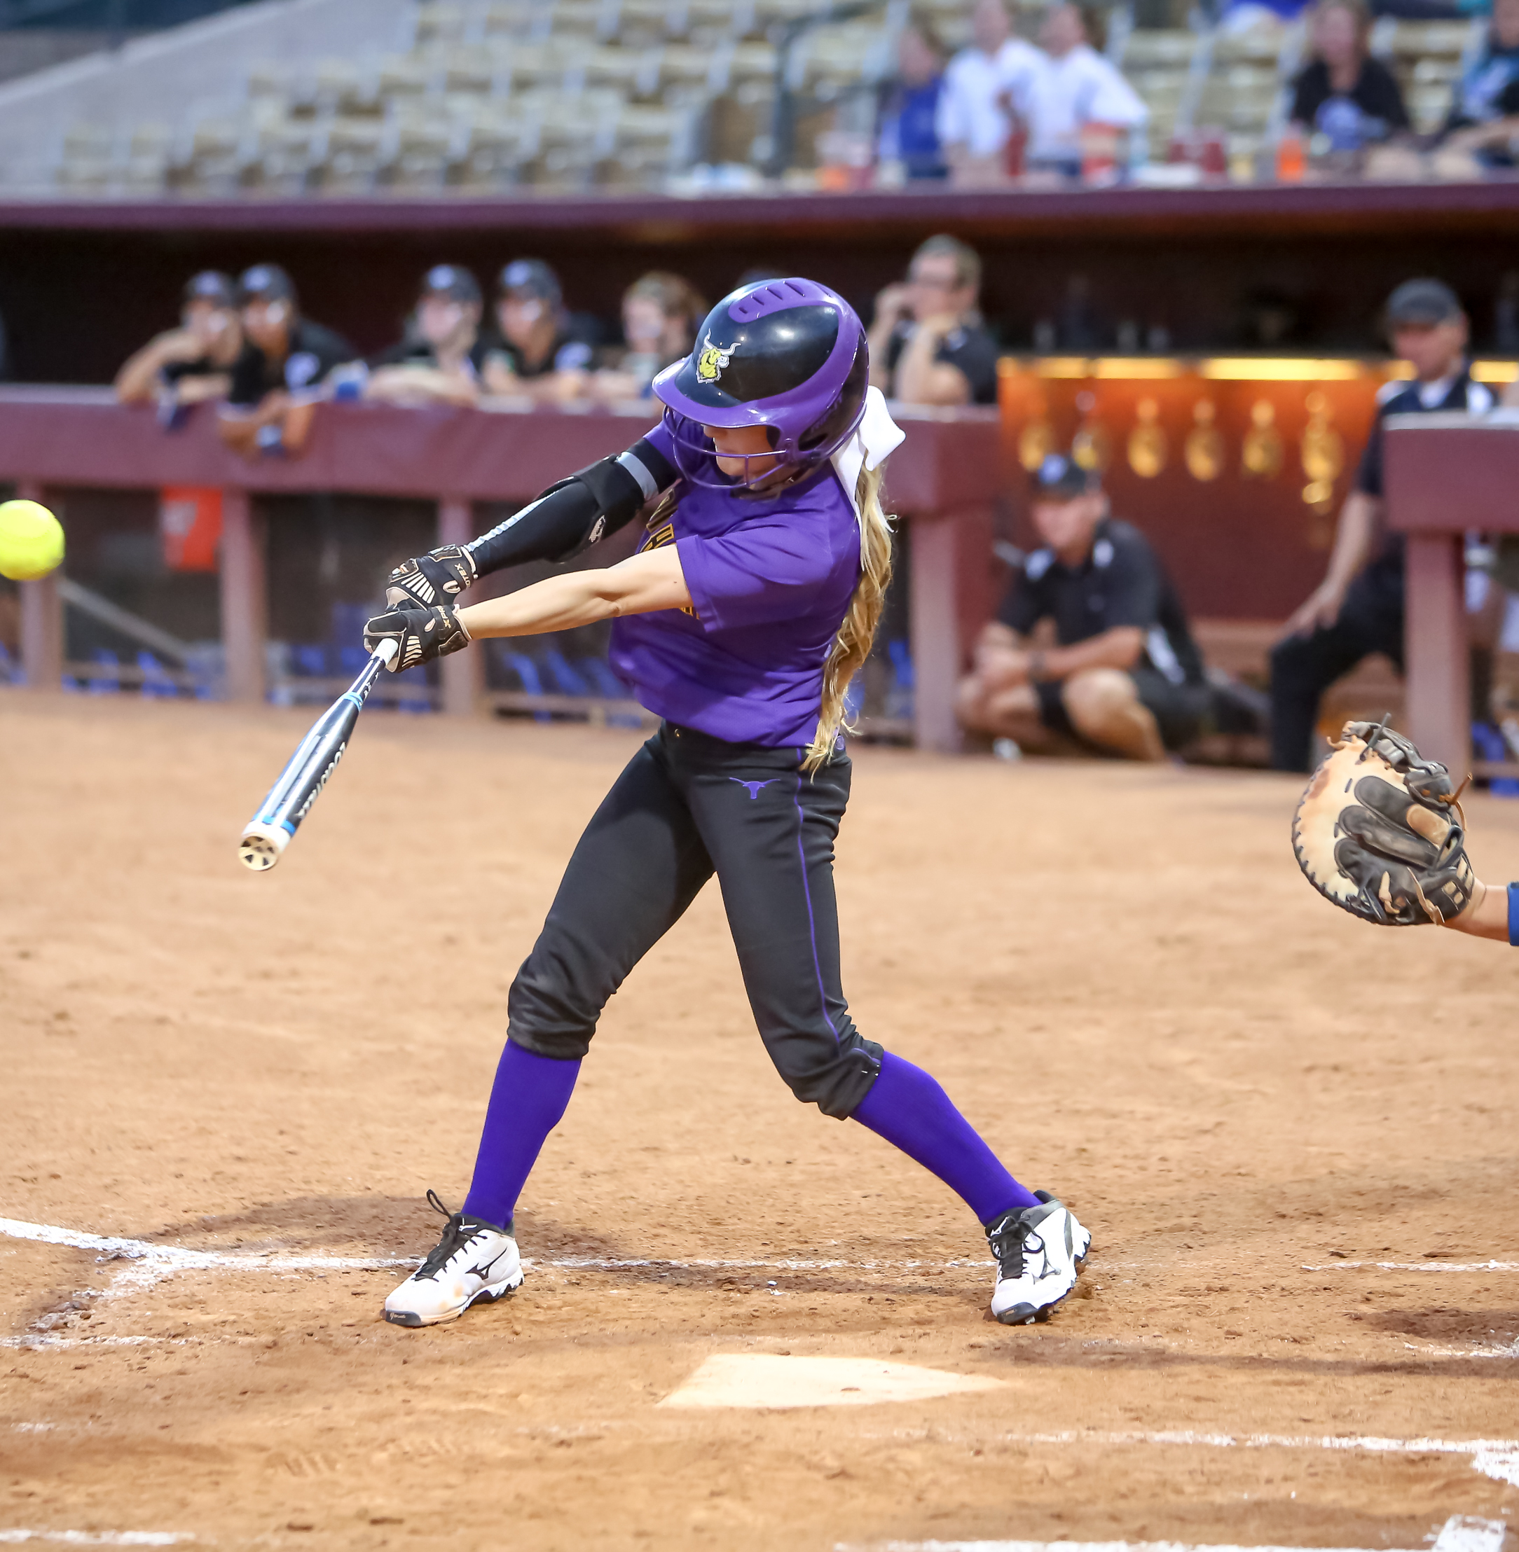
2026 NFHS SOFTBALL RULES CHANGES

Slide 3
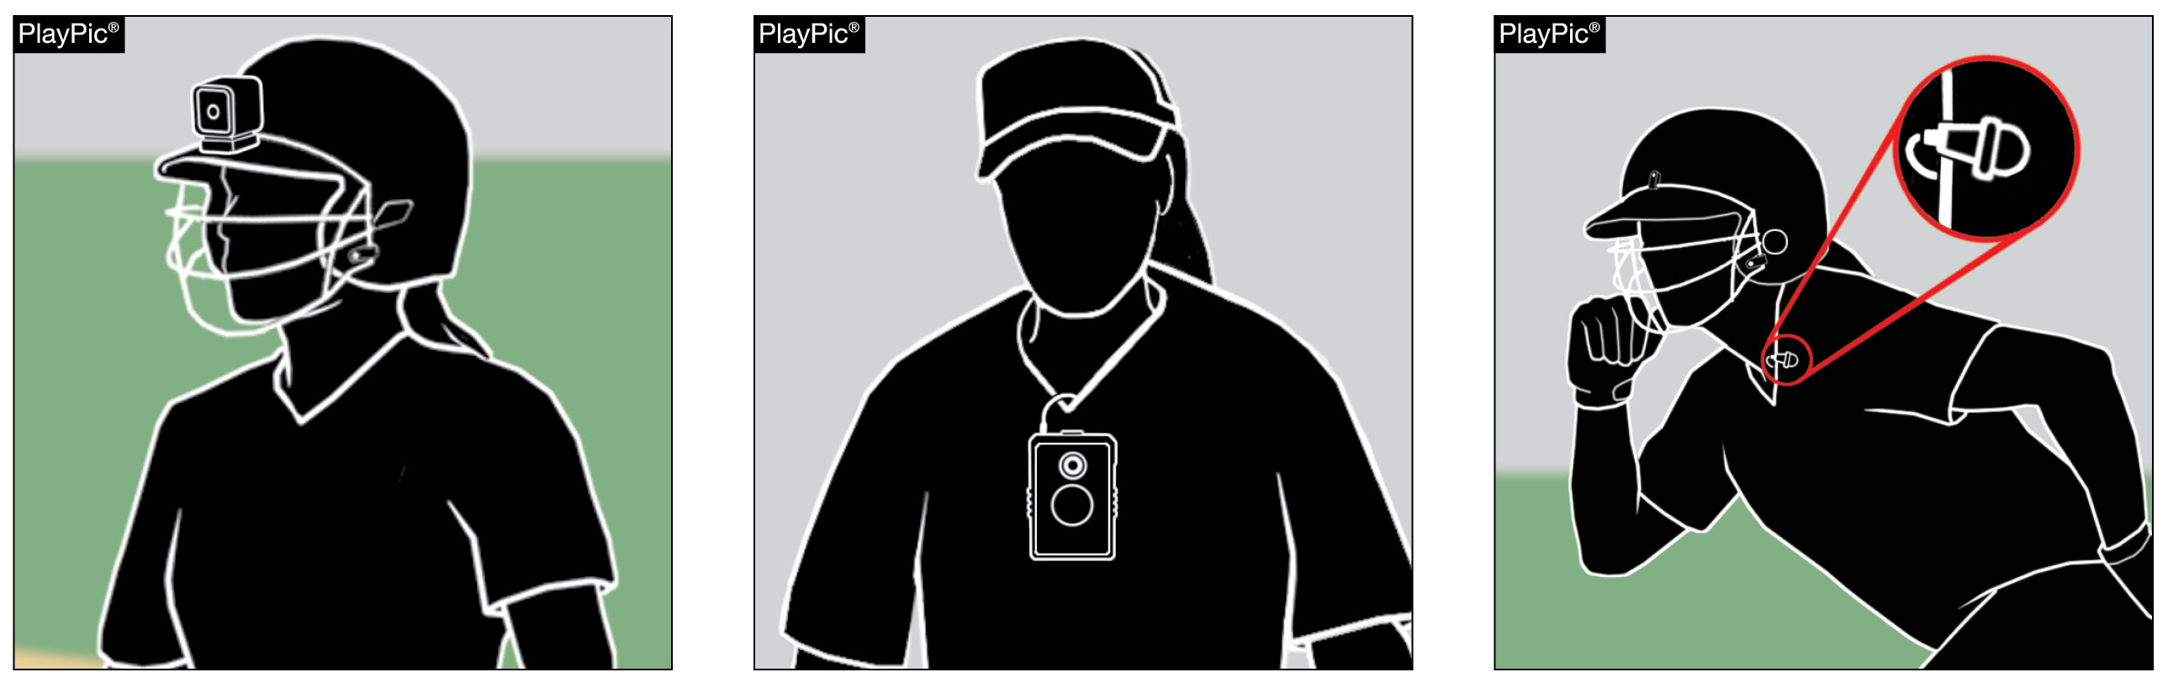
OTHER EQUIPMENT
1-9-6
Players shall not transmit or record audio or video from the playing surface.
Penalty: Ejection of the offender from the game, unless the offense is judged to be of a minor nature. If minor, the umpire may warn the offender and eject if the offense is repeated.
Notes:
OTHER EQUIPMENT 1-9-6:
Players shall not transmit or record audio or video from the playing surface.
Penalty: ejection of the offender from the game, unless the offense is judged to be of a minor nature. If minor, the umpire may warn the offender and eject if the offense is repeated.
Rationale: This change clearly defines the types of electronic devices prohibited by the rule.
Comments: With the increasing accessibility and use of electronic devices, it is important to establish clear boundaries for their use in competitive softball. Players shall not record audio or video while on the playing surface, as doing so presents significant safety risks and potential distractions that can compromise the integrity of the game. Movement and recording during live play—whether with handheld devices, wearable cameras, or phones—can interfere with a player's ability to perform safely and effectively. Handheld equipment may limit a player's capacity to catch or throw a ball, while wearable devices can become entanglement hazards or create impact risks during high-speed plays or collisions. Additionally, extra foot traffic or positioning for the sake of capturing footage can unintentionally place individuals in the path of play, leading to unnecessary contact or disruption. Beyond safety, the use of recording equipment on the field raises concerns around focus and liability. Players distracted by filming may not respond as quickly to the ball or to their teammates, and their inattention could increase the chance of injury. Moreover, audio recordings introduce privacy and liability considerations, especially when capturing conversations during competition. For these reasons, no player is permitted to record while on the field of play. The emphasis must remain on maintaining a safe, focused, and fair playing environment for all participants.

Slide 4
BATTER-RUNNER AND RUNNER
RULE 8
NFHS Rule 8 has been reformatted for clarity and consistency.
Section 4 was separated into two sections addressing runners entitled to advance with and without liability to be put out.
Remaining sections were renumbered.
Notes:
BATTER-RUNNER AND RUNNER Rule 8:
NFHS Rule 8 has been reformatted for clarity and consistency.
Section 4 was separated into two sections addressing runners entitled to advance with and without liability to be put out.
Remaining sections were renumbered.
Rationale: Added article references to PENALTIES and EFFECTS, and Section 4 was separated into two sections addressing runners entitled to advance with and without liability to be put out to delineate differences.
Comments: To improve clarity and enhance the overall usability of the rules, the existing content was reorganized into a structured outline format. This new layout allows for easier navigation and better comprehension of key concepts by clearly separating topics and presenting information in a logical, accessible sequence. One significant change involved dividing the original Section 8-4 into two distinct sections. This split more clearly distinguishes between situations in which runners are entitled to advance without liability to be put out and those where they advance with liability. By isolating these scenarios, officials, coaches, and players can more readily understand the conditions under which runners are protected or at risk during play. Additionally, article references were added to corresponding PENALTIES and EFFECTS. This change provides direct links between specific rule violations and their consequences, eliminating ambiguity and helping users quickly identify the appropriate rulings and applications. The result is a cleaner, more intuitive rule structure that supports accurate rule enforcement and improved learning.

Slide 5
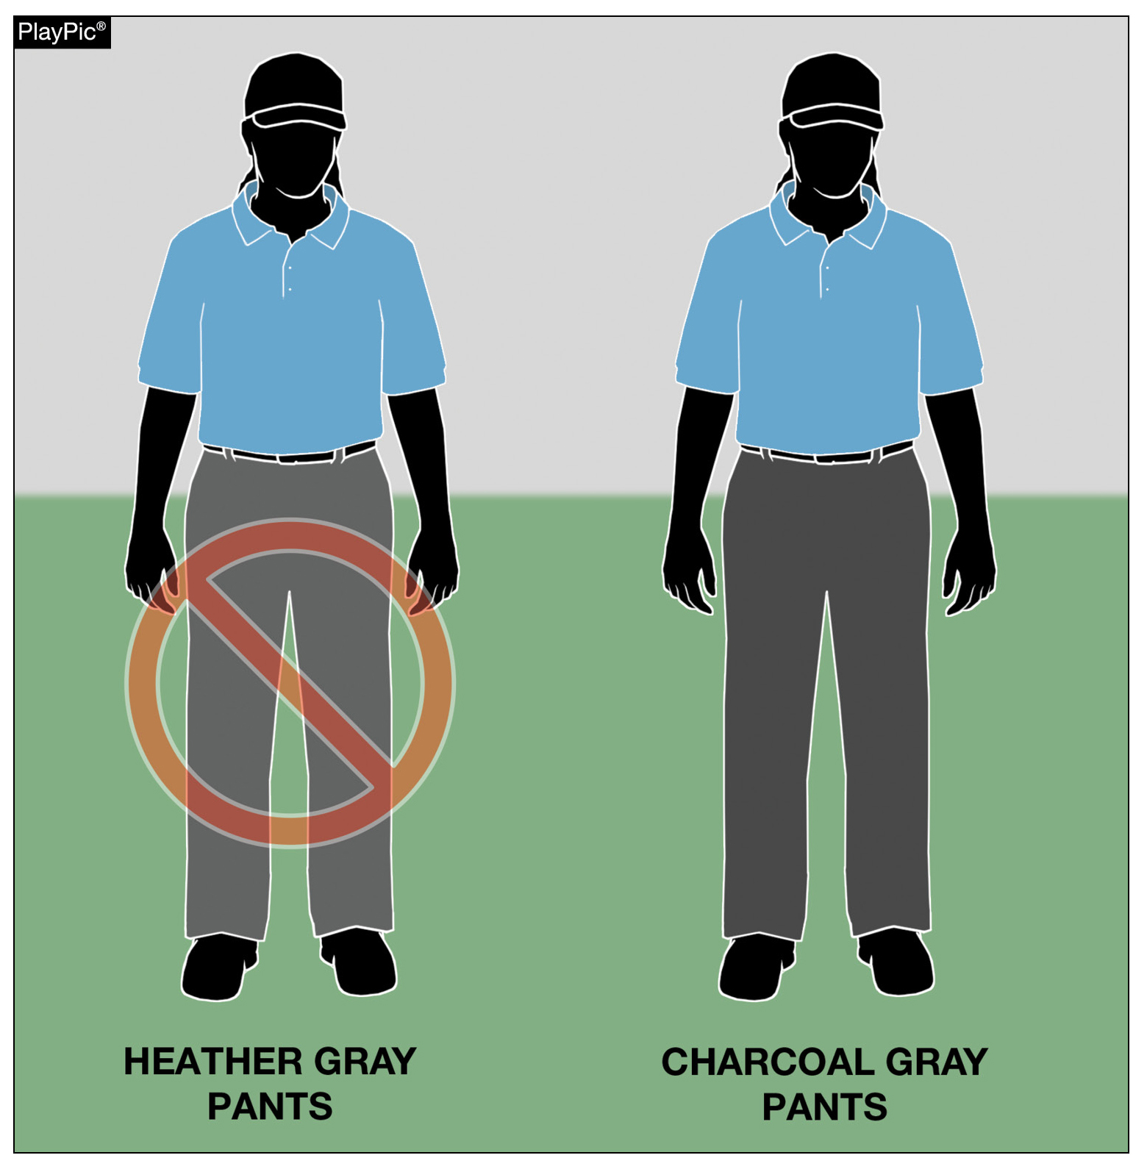
EQUIPMENT AND APPAREL
10-4-2
Umpires have the option of wearing heather gray, charcoal gray or navy blue slacks.
Effective January 1, 2027, heather gray slacks will no longer be permitted as part of the umpire's uniform.
Notes:
EQUIPMENT AND APPAREL 10-4-2:
Umpires have the option of wearing heather gray, charcoal gray or navy blue slacks.
Effective January 1, 2027, heather gray slacks will no longer be permitted as part of the umpire's uniform.
Rationale: Manufacturers have discontinued producing heather gray umpire pants. This change will assist umpires in the purchase of pants that are currently being manufactured.
Comments: Effective January 1, 2027, heather gray umpire pants will no longer be permitted for use, as manufacturers have discontinued their production. This update reflects a practical shift to ensure that umpires can purchase and wear uniform pants that are currently being manufactured and readily available through suppliers. Moving forward, umpires will be expected to wear pants in either charcoal gray or navy, both of which are actively produced and supported by major manufacturers. The transition to these colors—particularly charcoal gray—provides consistency in appearance while allowing state associations and officials to align with what is accessible in the current marketplace. This change comes in response to ongoing feedback from state associations, which emphasized the challenges officials face in locating heather gray pants and the need for standardized, available uniform options. By establishing a clear implementation date and aligning with existing production trends, this adjustment supports both uniformity and ease of compliance across all levels of competition. Pants in either heather or charcoal gray will be legal until January 1, 2027, when charcoal pants will be required.

Slide 6
2026 NFHS SOFTBALL EDITORIAL CHANGES

Slide 7
UNIFORMS, PLAYER EQUIPMENT
1-6 (NEW)
Uniform language from Rule 3-2 has been moved to
Rule 1-6 to align with other NFHS rules book language on equipment and uniform.
Rule 1 Sections 6 through 8 have been renumbered to reflect this change.
Rule 3 has been renumbered.
Notes:
UNIFORMS, PLAYER EQUIPMENT 1-6 (NEW):
Uniform language from Rule 3-2 has been moved to Rule 1-6 to align with other NFHS rules books.
Rule 1 Sections 6 through 8 have been renumbered to reflect this change.
Rule 3 has been renumbered.
Rationale: Placing uniform language in Rule 1 is consistent with other NFHS rule language.

Slide 8
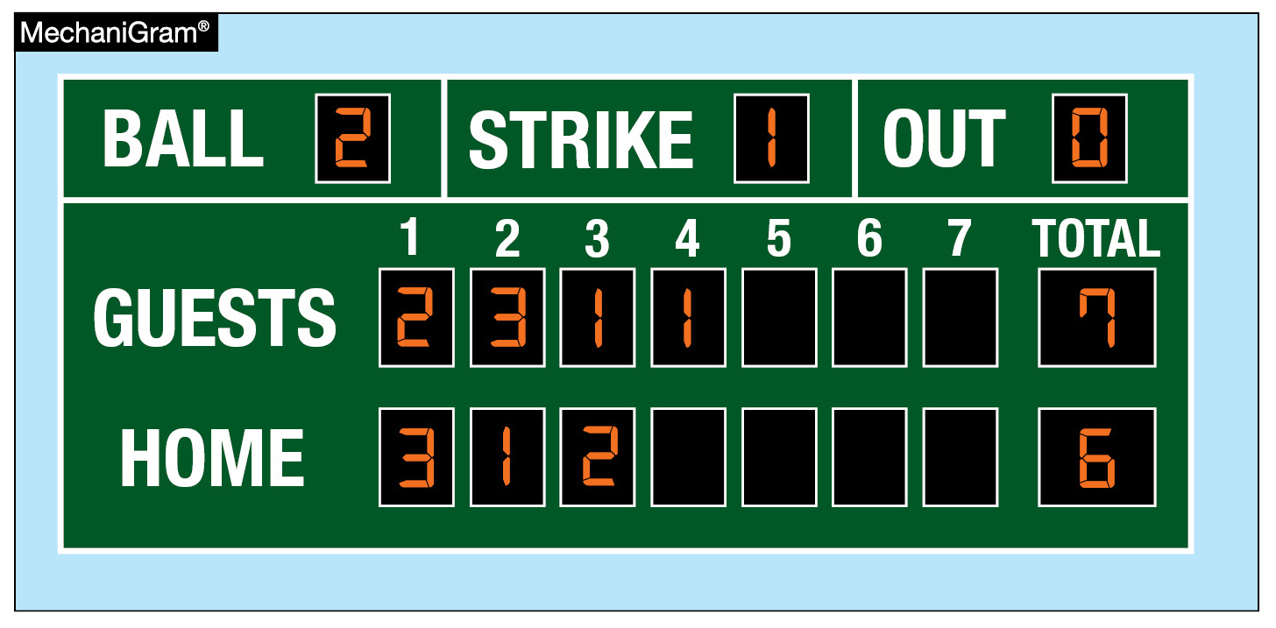
FORFEITED GAME
4-3-2
If a game is forfeited after the number of innings required for a regulation game and the offending team is behind the score remains as recorded.
Notes:
FORFEITED GAME 4-3-2:
If a game is forfeited after the number of innings required for a regulation game and the offending team is behind the score remains as recorded.
Rationale: Language was reworded for clarity.

Slide 9
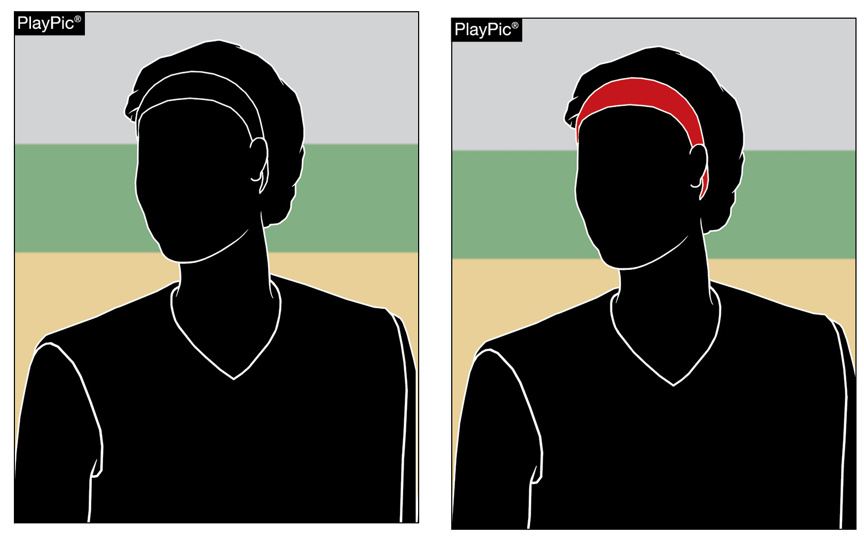
UNIFORMS, PLAYER EQUIPMENT
3-2-5 CASE BOOK
Edits to 3.2.5 Situations B & C reflect rule change for 2025.
There are no color restrictions for headbands.
Notes:
UNIFORMS, PLAYER EQUIPMENT 3-2-5 CASE BOOK:
Edits to 3.2.5 Situations B & C reflect the 2025 rule change.
There are no color restrictions for headbands.
Rationale: Correction to reflect a rule change in the 2025 rules book.

Slide 10
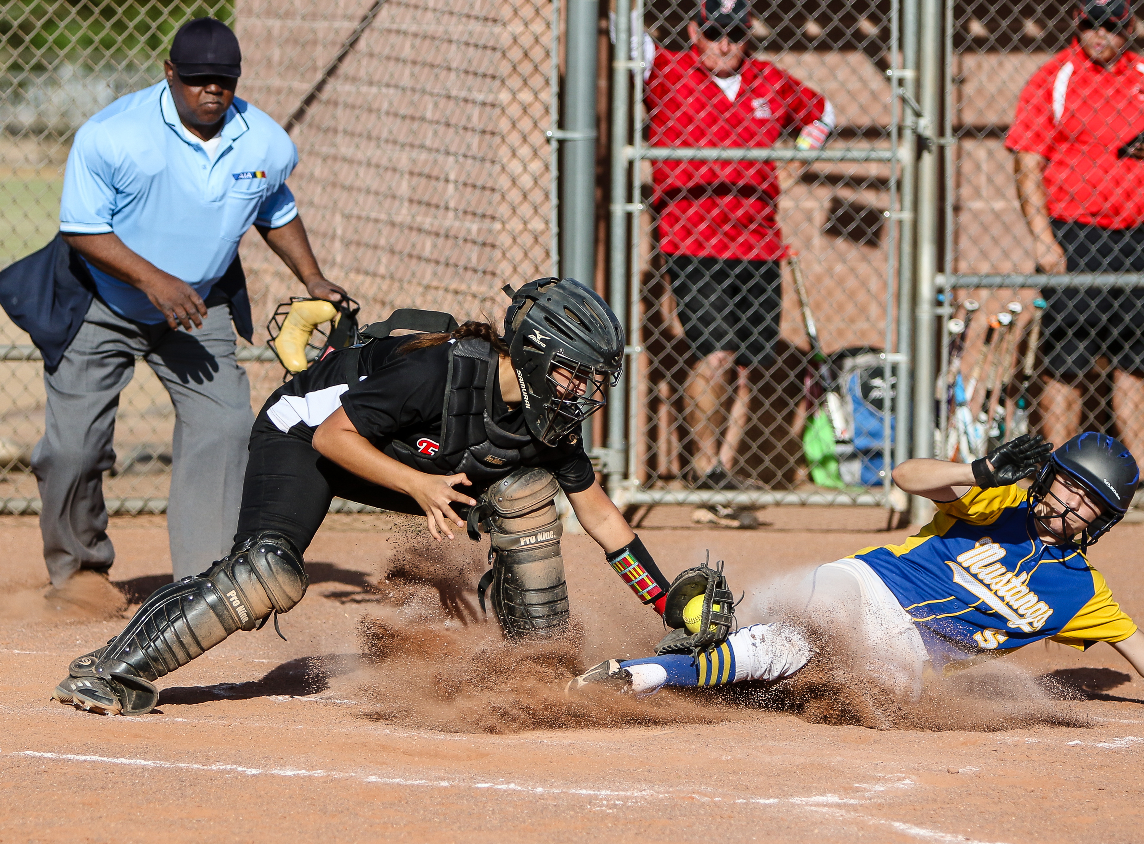
2026 NFHS SOFTBALL POINTS OF EMPHASIS

Slide 11
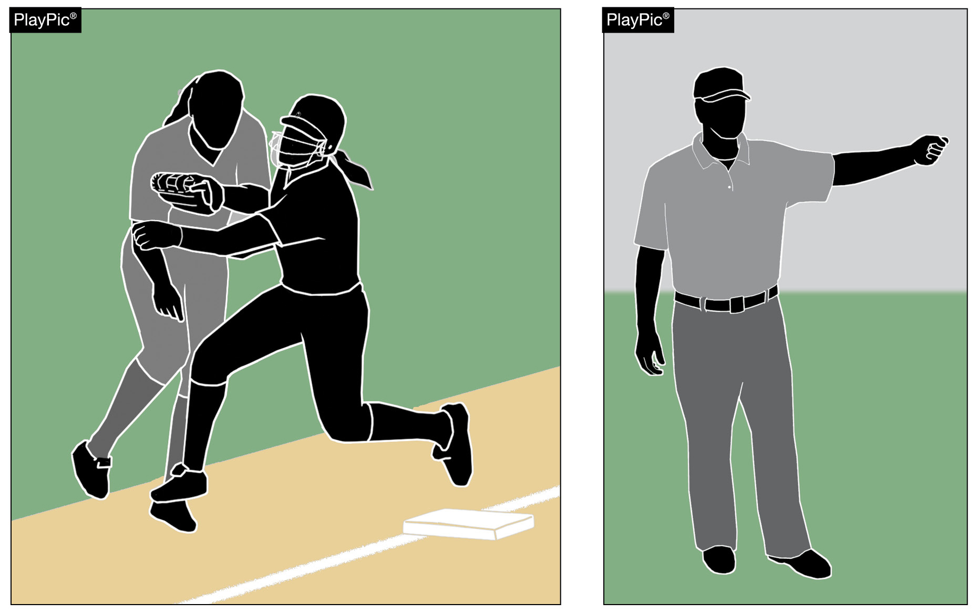
OBSTRUCTION
Obstruction is the act of a defensive team member that:
hinders or impedes a batter’s attempt to make contact with a pitched ball, or
impedes the progress
of a runner or batter-runner legally running the bases.
Notes:
Obstruction
Obstruction is defined as the act of a defensive player who hinders or impedes a batter’s attempt to make contact with a pitch or interferes with the legal progress of a runner or batter-runner advancing on the bases. This interference may be intentional or unintentional, and it can be either physical or verbal. However, obstruction does not apply if the defensive player is in possession of the ball or is making the initial play on a batted ball.

Slide 12
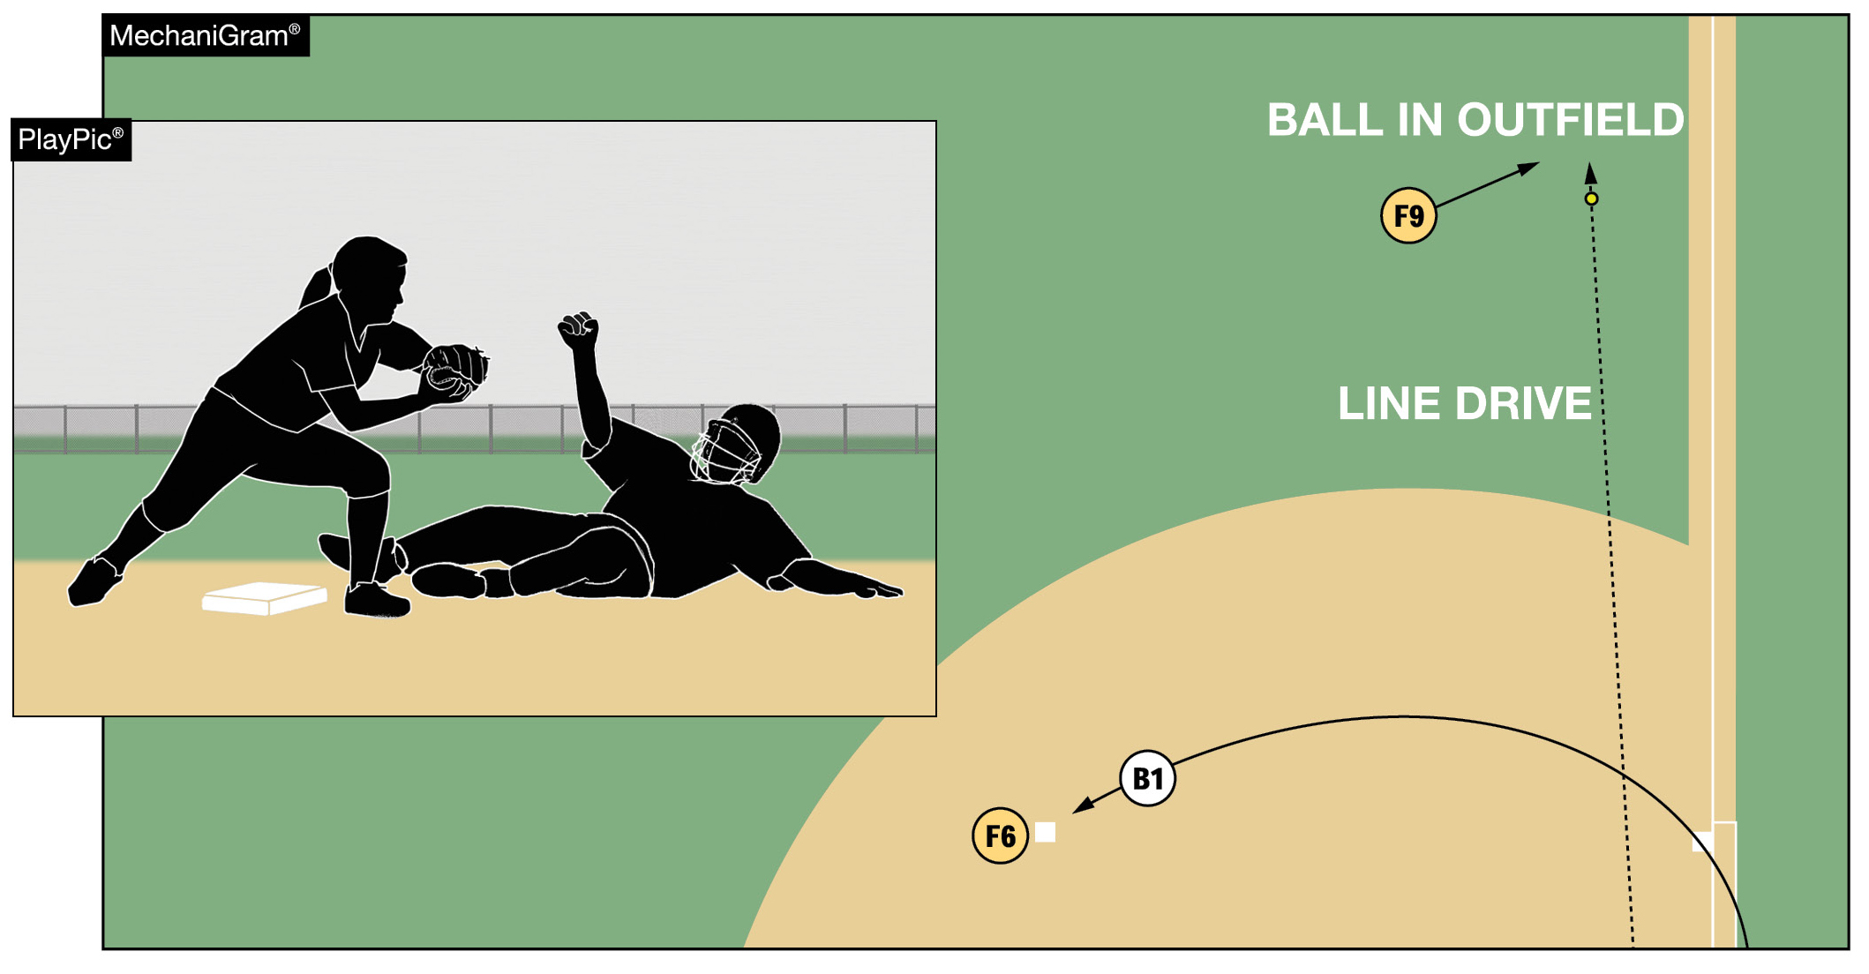
OBSTRUCTION
If the runner or batter-runner is not impeded, there is no obstruction.
With the exception of a fake tag, as shown, a fielder’s actions or positioning alone can never result in an obstruction ruling.
Notes:
Obstruction
Impeding a runner means creating a negative effect on their ability to run the bases. This might include a runner slowing down, altering their intended path, stopping altogether, retreating to the previous base, or making contact with a fielder that disrupts their movement. These examples underscore that the umpire must rely on judgment to determine both whether the runner was impeded and to what extent their progress was affected.

Slide 13
OBSTRUCTION
Impeding a runner means creating a negative effect on their ability to run the bases. This might include:
a runner slowing down
altering their intended path
stopping altogether
retreating to the previous base, or
making contact with a fielder that disrupts their movement
The umpire must rely on judgment to determine both whether the runner was impeded and to what extent their progress was affected.
Notes:
Obstruction
Unlike many rule violations in softball that carry standardized penalties—such as awarding two bases for a thrown ball that goes out of play or one base for a pitched ball entering dead ball territory—obstruction rulings are situational and vary based on the specifics of each play. The purpose of the obstruction award is not to penalize the defensive team arbitrarily, but to nullify the negative effect of the obstruction. The runner is not being granted an advantage; rather, they are being restored to the position they would have achieved had the obstruction not occurred. This could mean advancing the runner or, in some cases, returning them to a previous base—whatever is necessary to correct the disruption caused by the obstruction, based on the umpire’s judgment.

Slide 14
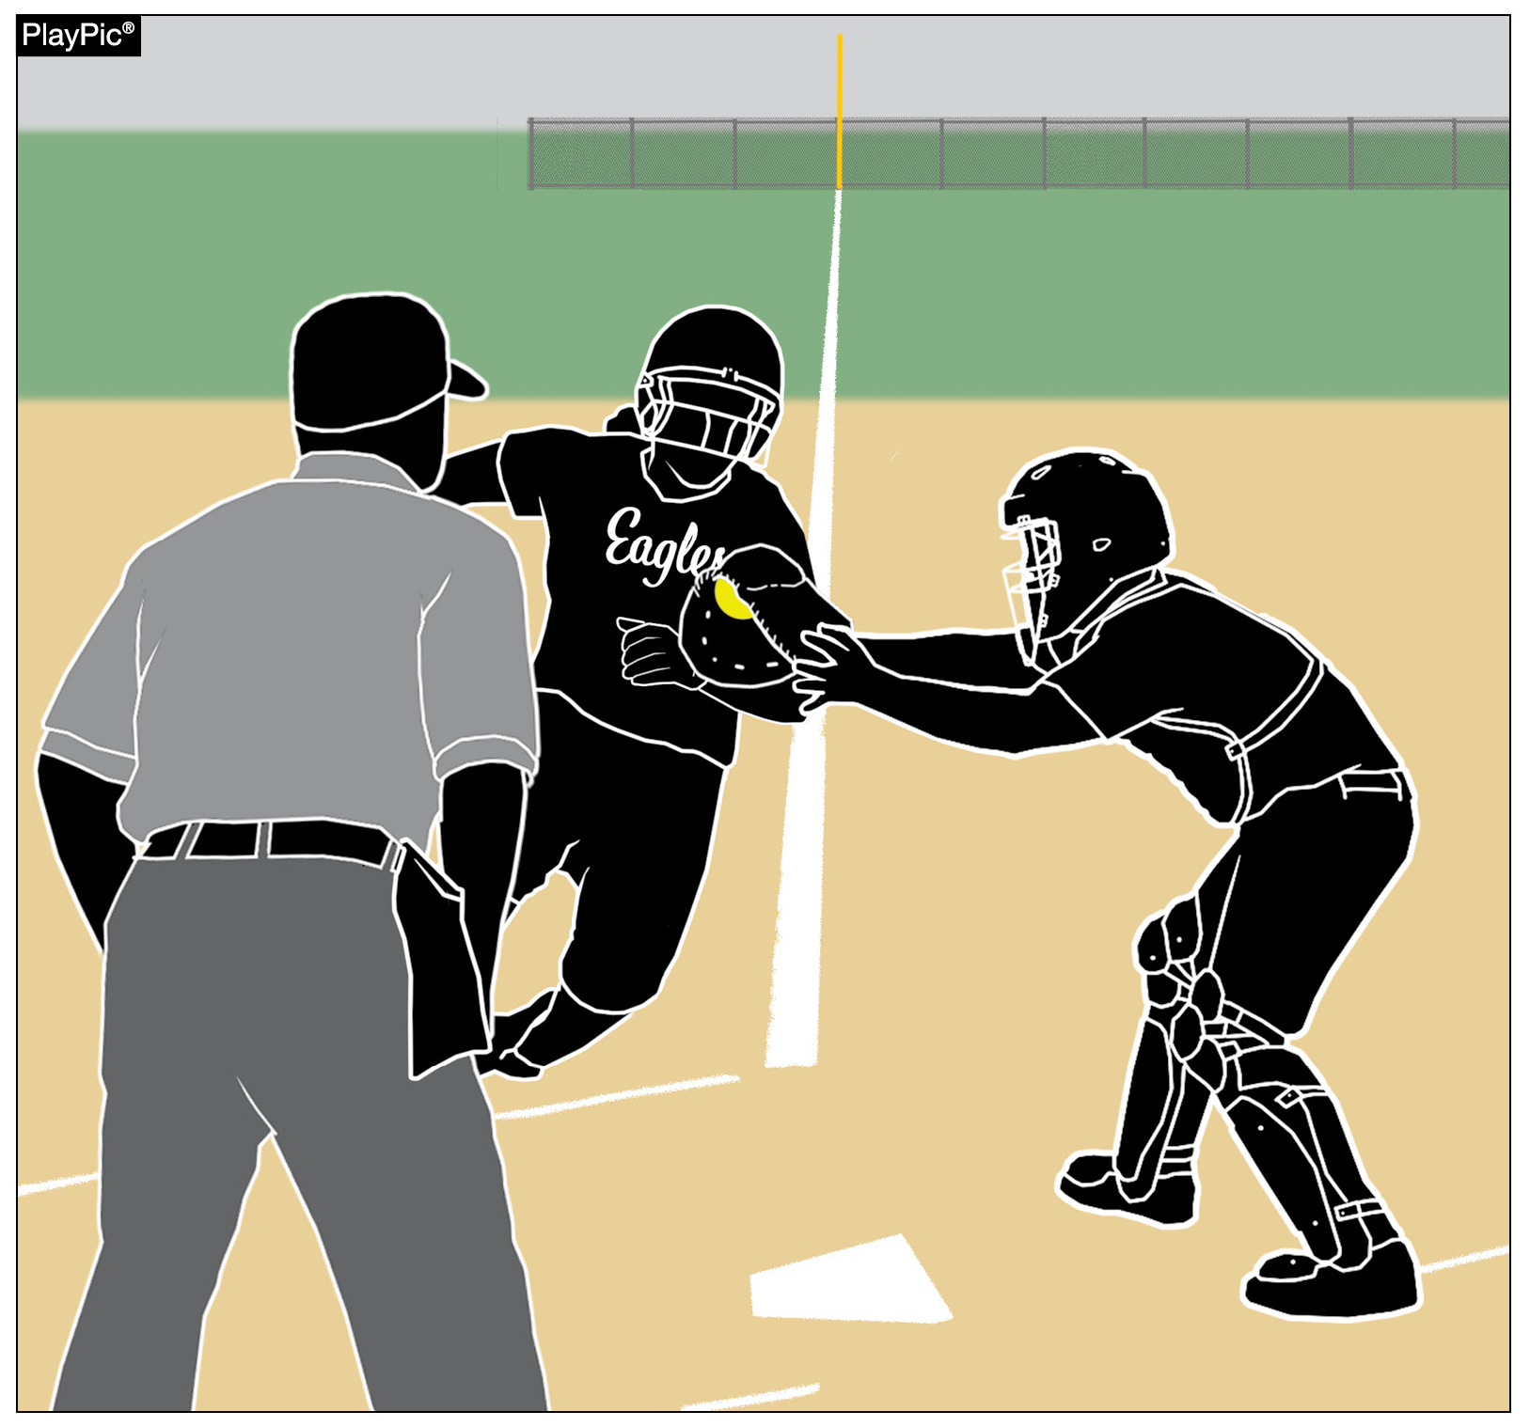
MAINTAINING AN UNOBSTRUCTED VIEW
Verbiage has been added to the 2026-28 NFHS Softball Umpire Manual to provide guidance to umpires when it is necessary to move from the primary position during a play.
This movement allows umpires to keep the following items in view:
Defense contacting offense with the ball (tagging the runner).
Defense maintaining control of the ball during the tag.
Offense contacting the base.
Notes:
Maintaining an Unobstructed View of the Play
There are times when an umpire must move from their primary position to maintain an unobstructed view of a play. This is mentioned several times in the NFHS Softball Umpire Manual but, until now, there has not been any guidance for the umpire in the manual. Information has been added to the Umpire Manual to explain aspects of the play that should be considered when moving from the primary position to maintain an unobstructed view of the play.
There are key interactions of the four elements (offense, defense, ball, and base) on each play that need to be viewed clearly in order to make a judgment call. On tag plays:
Defense contacting the offense with the ball (tagging the runner).
Defense controlling the ball through the process of applying the tag.
Offense contacting the base.

Slide 15
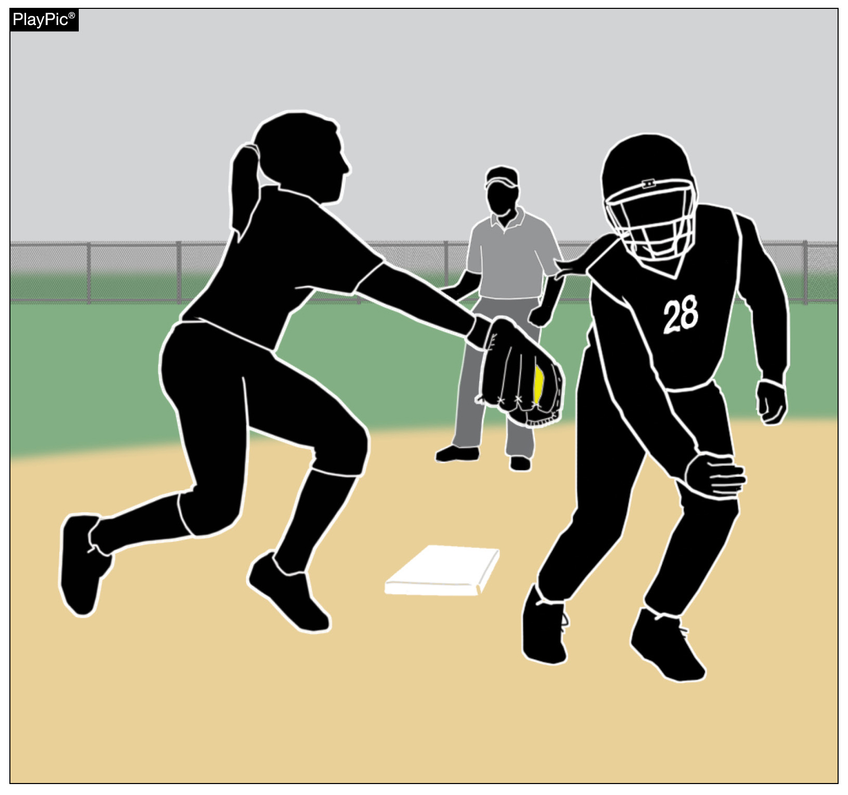
MAINTAINING AN UNOBSTRUCTED VIEW
Umpires must maintain proper distance while adjusting to keep all three interactions in view. Prior to umpires moving from their primary position, key elements of the play need to be understood. These include:
Fielder positioning.
Location, direction and height of the incoming throw.
Runner’s path.
Timing of the throw and the runner arriving near the base.
Notes:
Maintaining an Unobstructed View of the Play
All three of these key interactions must remain within the umpire’s view in order to make an accurate judgment call on the play. Also, when adjusting an umpire needs to maintain proper distance as to ensure no key interactions of the play are missed.
Details of each play like:
Defensive positioning.
Direction, height and timing of the throw.
Path of the runner.
Timing of the ball and runner arriving near the base.

Slide 16
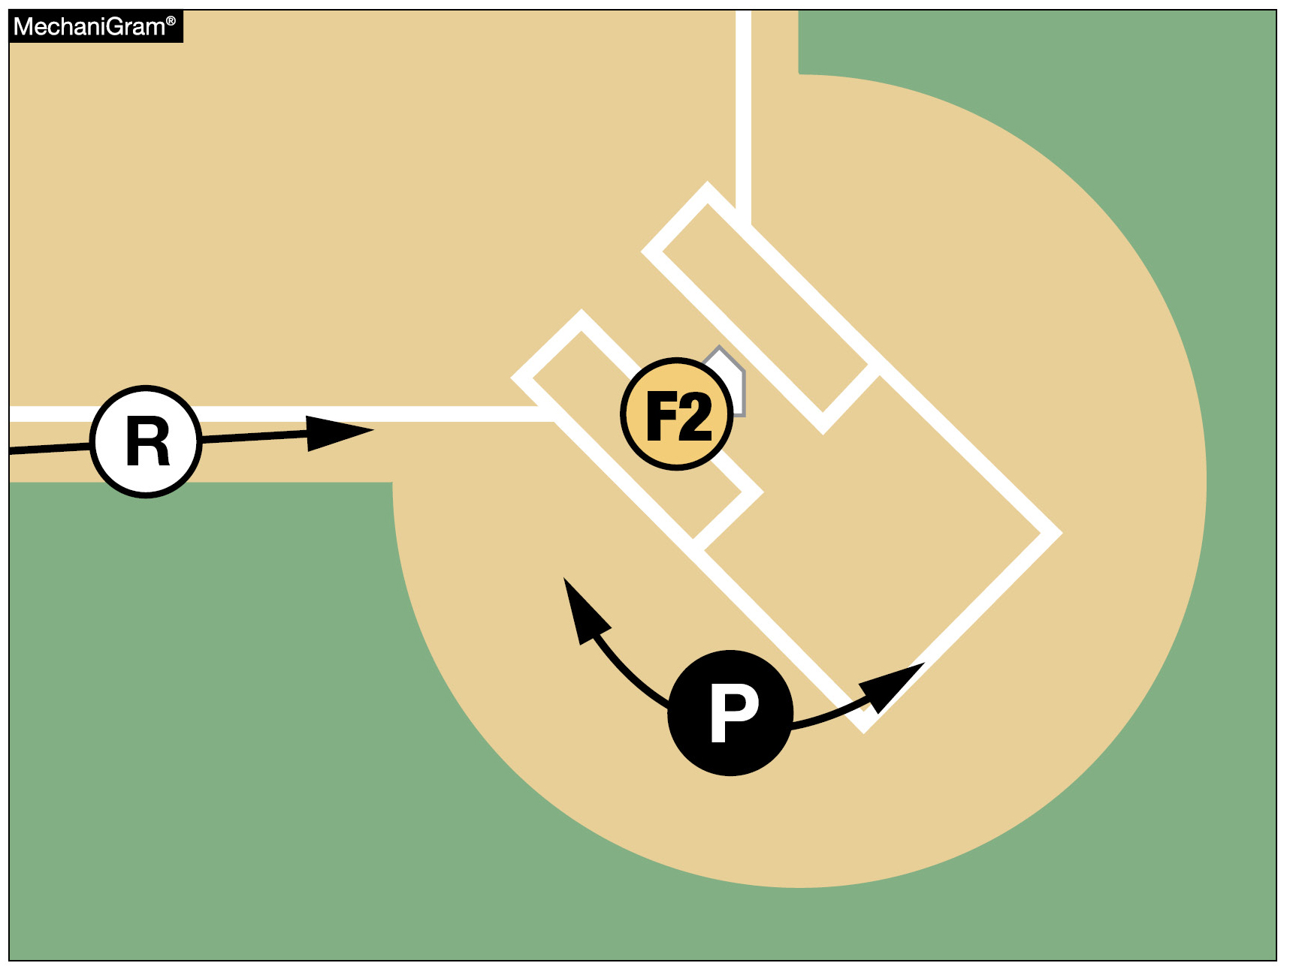
MAINTAINING AN UNOBSTRUCTED VIEW
On plays at the plate, the plate umpire should start with a primary position near the intersection of the back-left corner of the right-handed batter’s box, as shown.
Then the umpire should move left or right in order to maintain an unobstructed view of all the key interactions of the play.
Notes:
Maintaining an Unobstructed View of the Play
All these items need to be evaluated in each particular play prior to moving from the primary positioning as each play develops slightly differently. Understanding how these items are going to come together on a particular play allows the umpire to determine where the key interactions will occur, allowing them to adjust, when necessary, to maintain an unobstructed view of the play.

Slide 17
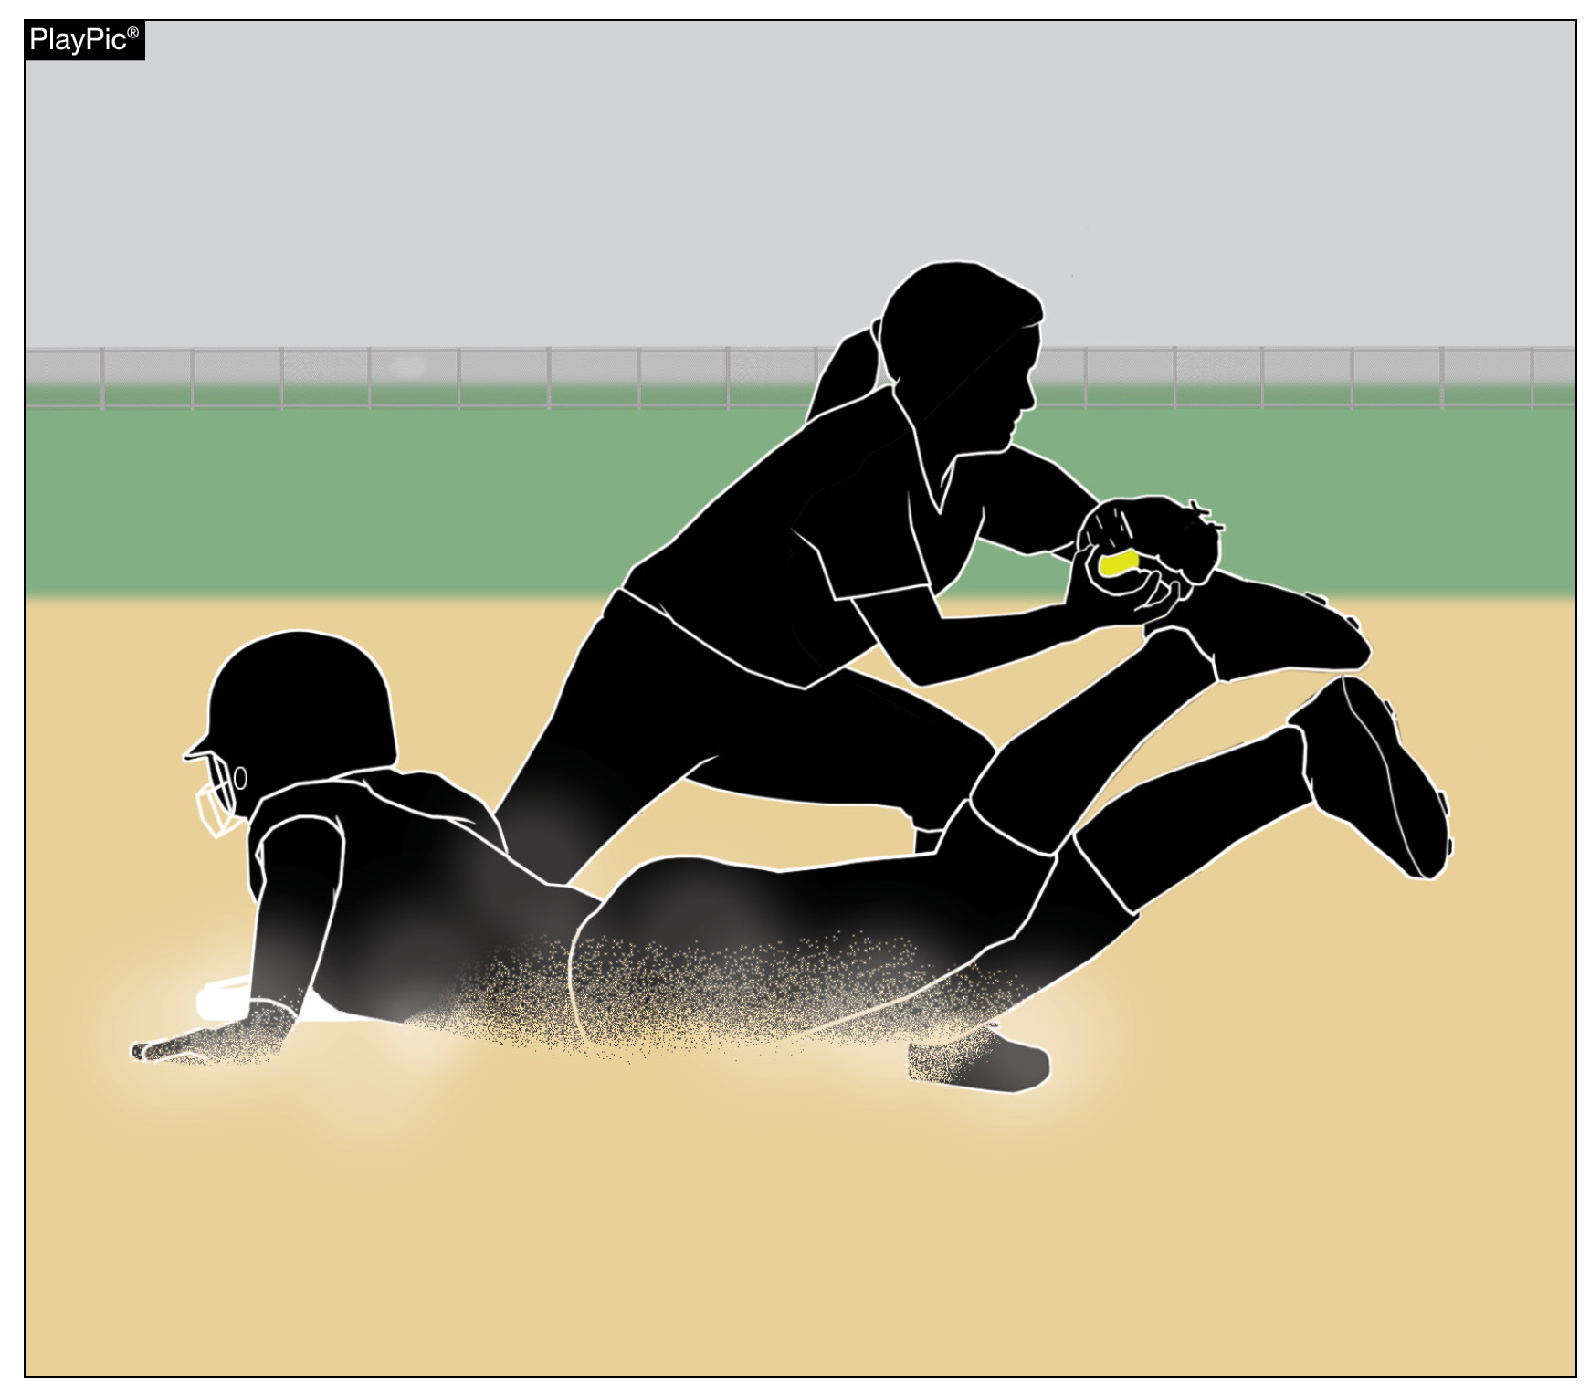
MAINTAINING AN UNOBSTRUCTED VIEW
All of these elements must be understood prior to umpires adjusting their positioning.
This is simply another example of an umpire requiring good timing in order to get calls correct.
Reading the play correctly allows umpires to adjust their position in order to maintain a view of the play, instead of becoming straightlined.
Notes:
Maintaining an Unobstructed View of the Play
All of these elements must be understood prior to umpires adjusting their positioning.
This is simply another example of an umpire requiring good timing in order to get calls correct.
Reading the play correctly allows umpires to adjust their position in order to maintain a view of the play, instead of becoming straightlined.

Slide 18
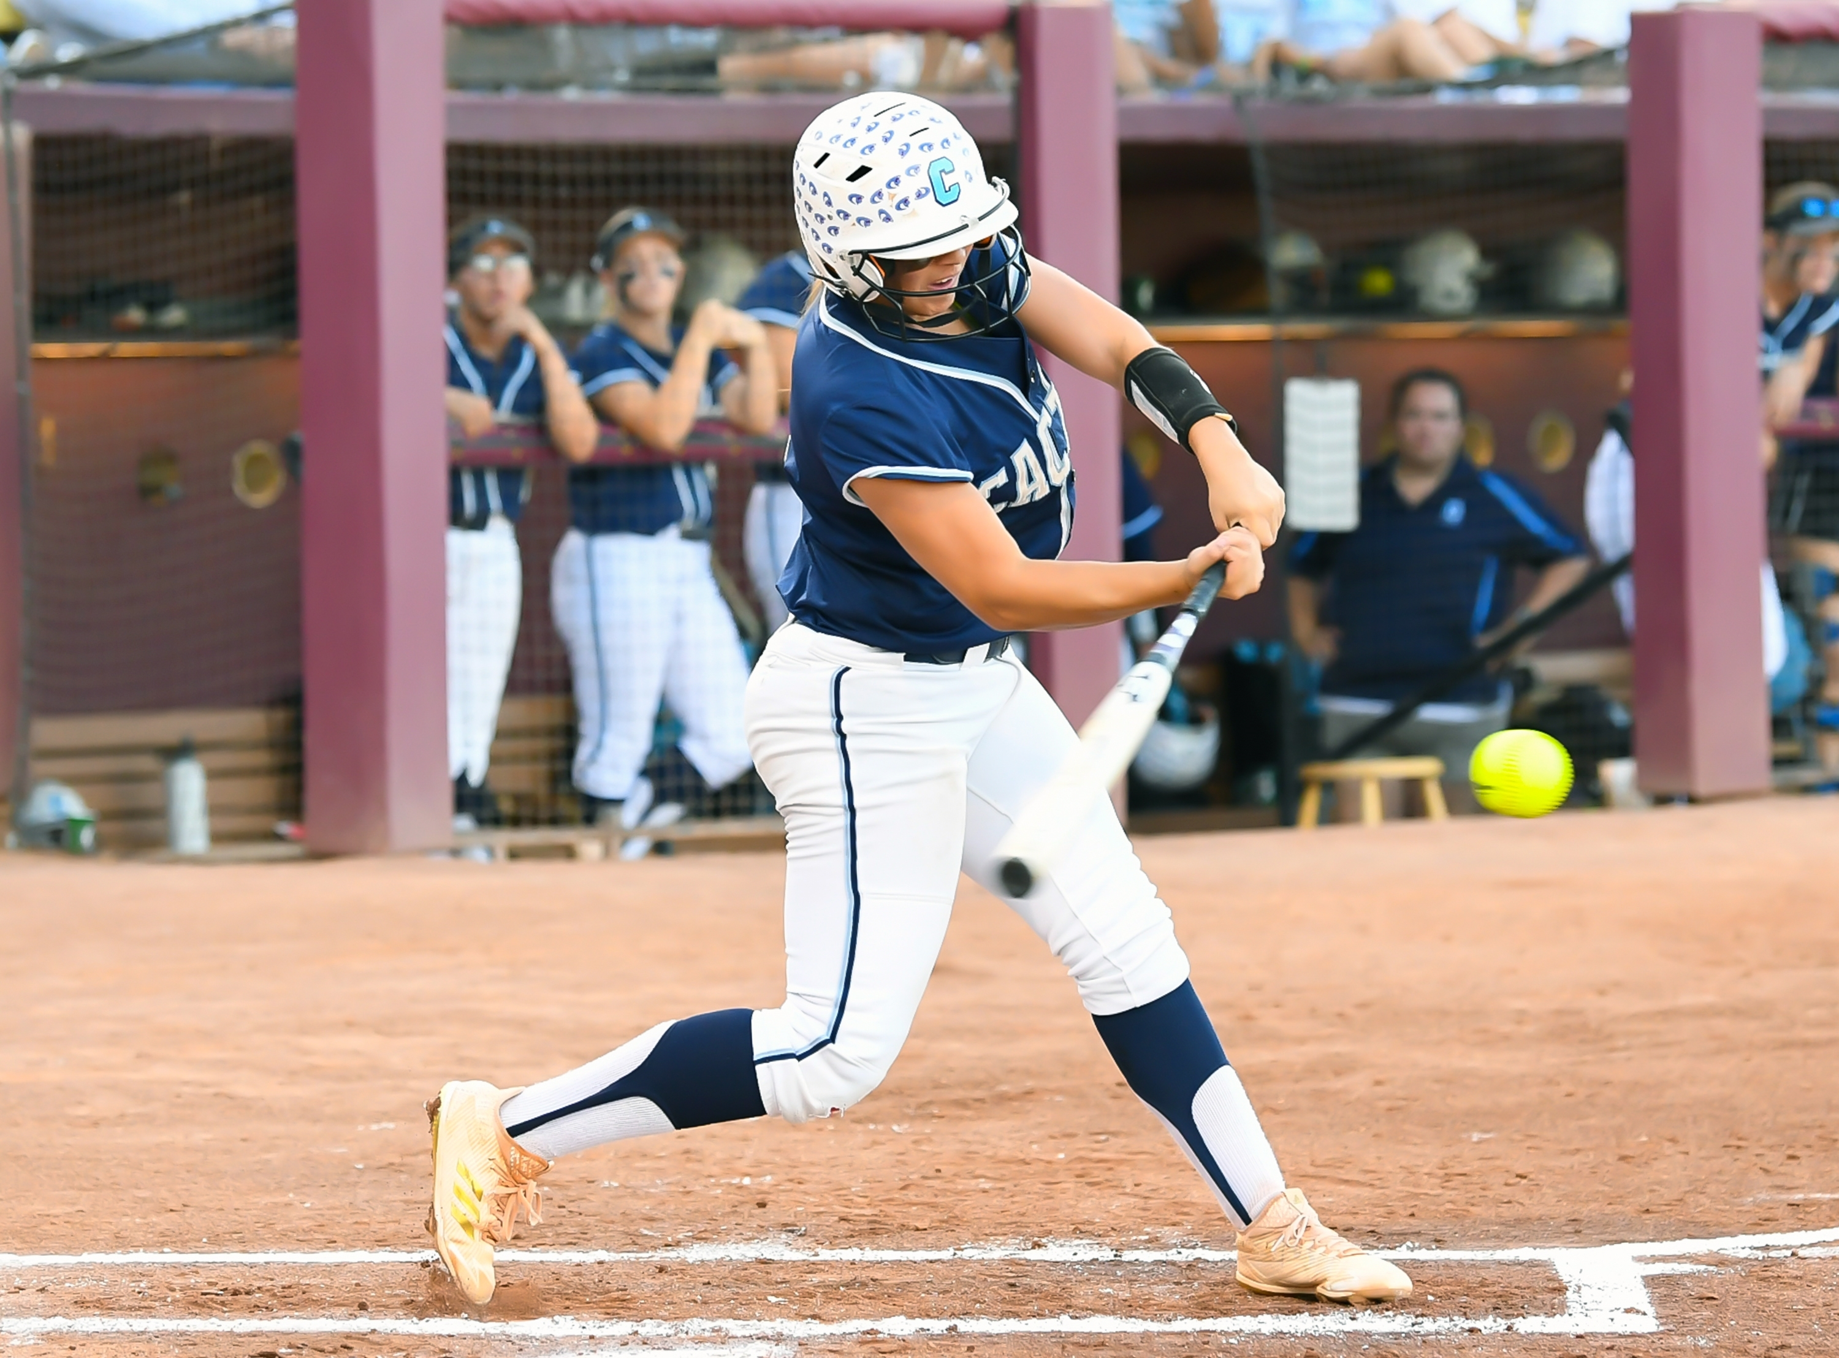
NFHS OFFICIALS EDUCATION

Slide 19
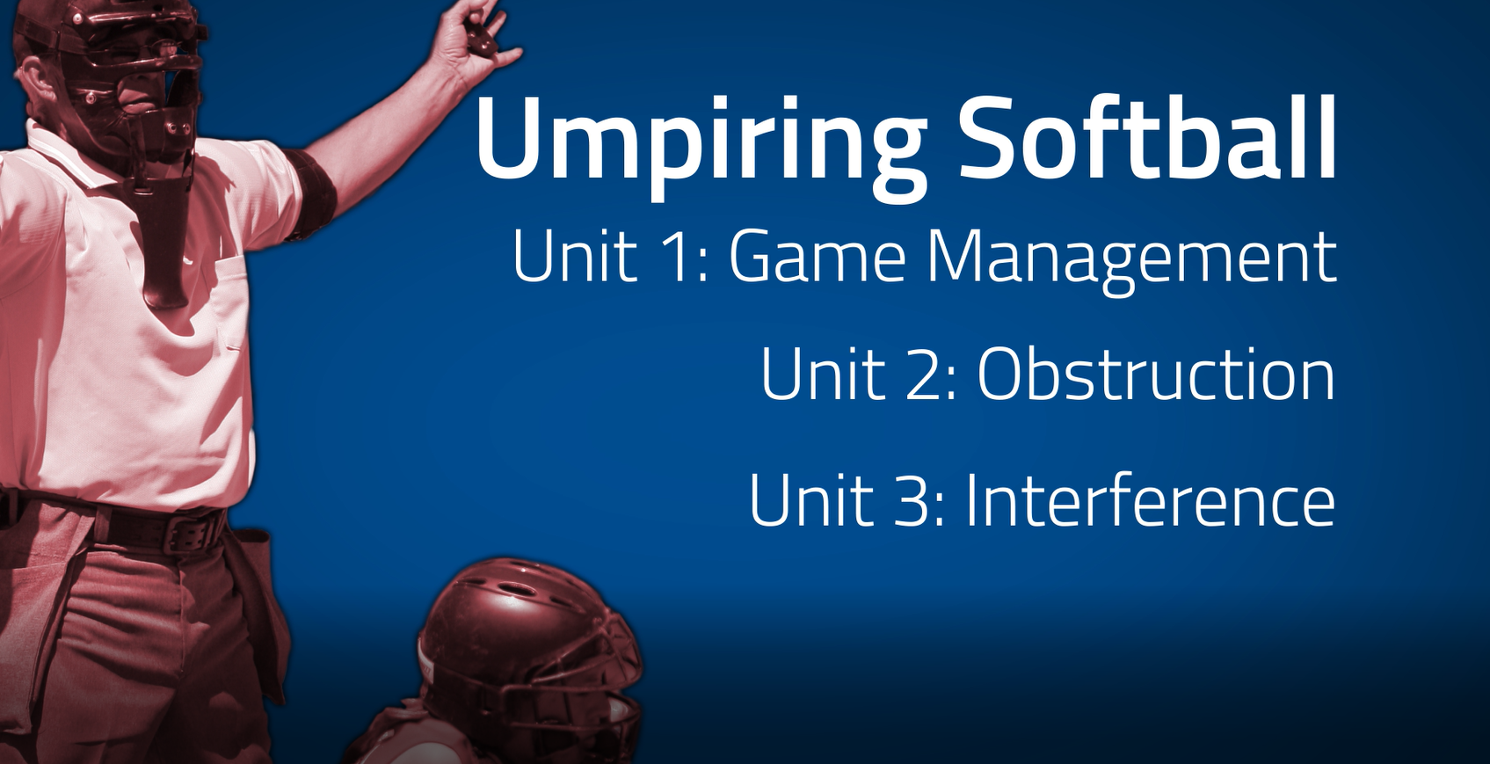
www.nfhs.org
Notes:
UMPIRING SOFTBALL
In partnership with USA Softball, the NFHS has developed the first in a line of educational softball courses. This first course addresses game management as well as obstruction and interference.

Slide 20
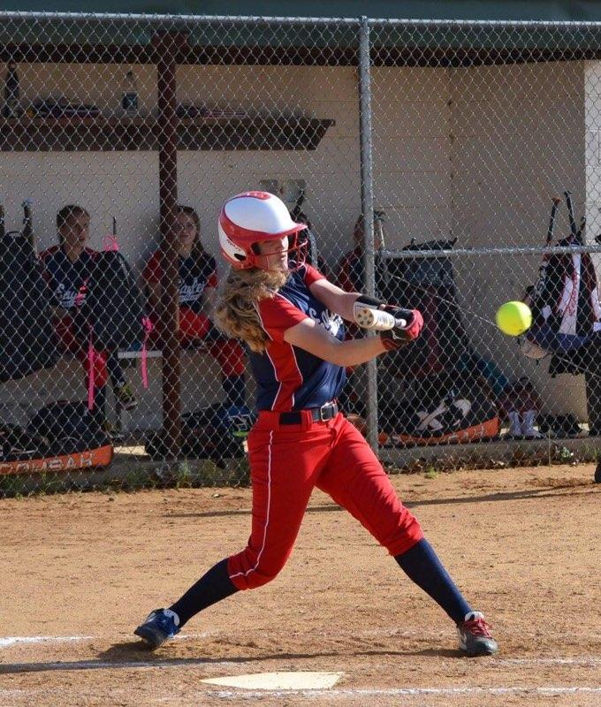
NFHS Authentication Mark Update

Slide 21



NFHS Authenticating Mark Update
Specifications
Do not use the NFHS Authenticating Mark without prior written approval from the NFHS
This mark is for use of licensees only.
Minimum size
  Inflatable Balls - 2 ½“ in length (Basketball, Football, Soccer, Volleyball, and Water Polo)
  Non-Inflatable Balls - 1 ¼" in length (Baseball, Field Hockey, Ice Hockey Puck, Lacrosse, and Softball)
  On a ball or puck, the NFHS mark may be smaller than manufacturer’s logo, but should be placed in proximity to the manufacturer’s name for easy identification. Allow enough space around the mark so it can be easily recognized as distinct and separate.
  Reproduce the mark only from the vector artwork provided on Direct Licensing Hub. Do not copy, scan art electronically or use as a template to redraw the symbol.
Note: If sizing or specifications do not work well in your particular design situation, contactK12 Licensing.
Old Logos
Current Logo

Slide 22
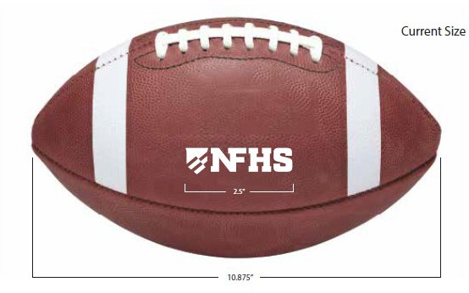
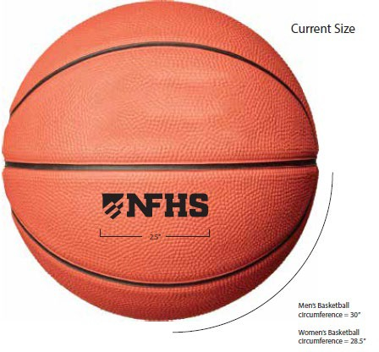
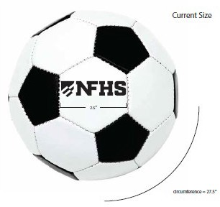
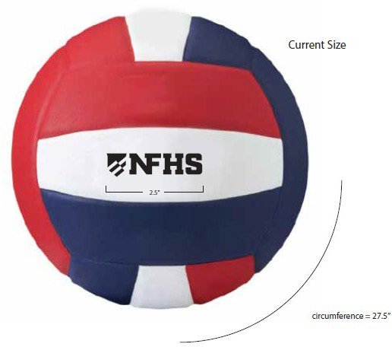
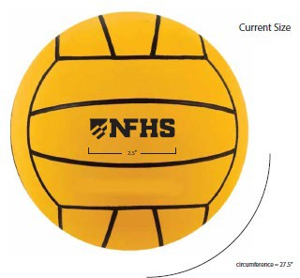
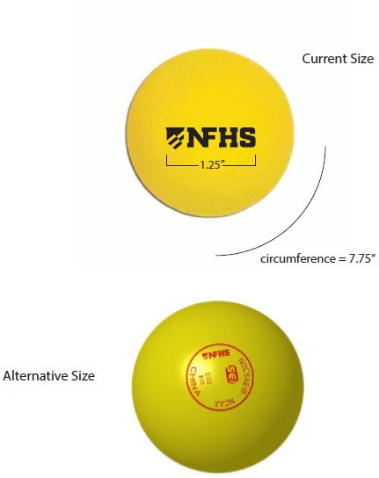
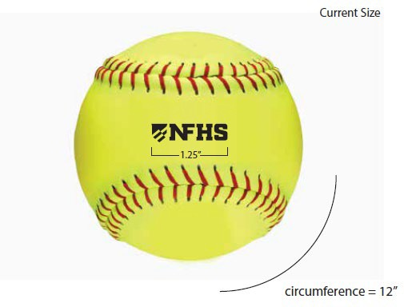
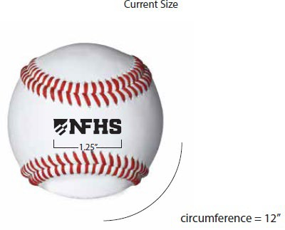
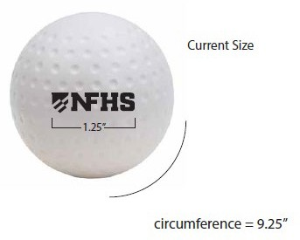
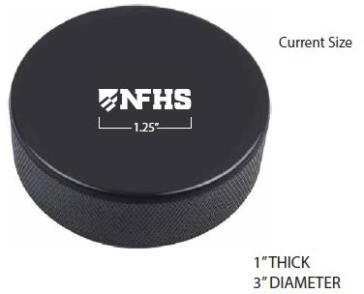
NFHS Authenticating Mark Update
A current list of NFHS authenticated products can be found at www.nfhs.org, Resources, Authenticating Mark.

Slide 23
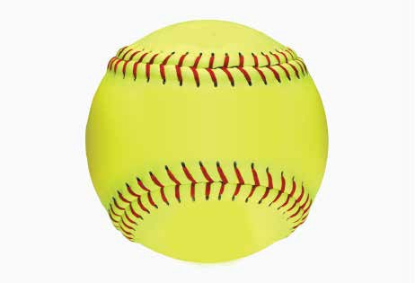


Softball
Old Size
Current Size
1.25”
circumference = 12”
circumference = 12”

Slide 24

2026 NFHS SOFTBALL RESOURCES

Slide 25




NFHS SOFTBALL PUBLICATIONS
NFHS Rules Books, Case Books, and other Softball materials can be ordered online at www.nfhs.com, or by calling
1-800-776-3462.
Notes:
NFHS SOFTBALL PUBLICATIONS
The NFHS softball publications are available to order online or by using the toll-free number.

Slide 26

NFHS SOFTBALL PUBLICATIONS
The new NFHS Softball Pre-Season Guide will be available on or before November 1, 2025.
Notes:
The NFHS Softball Guide will be available on or before November 1st.

Slide 27
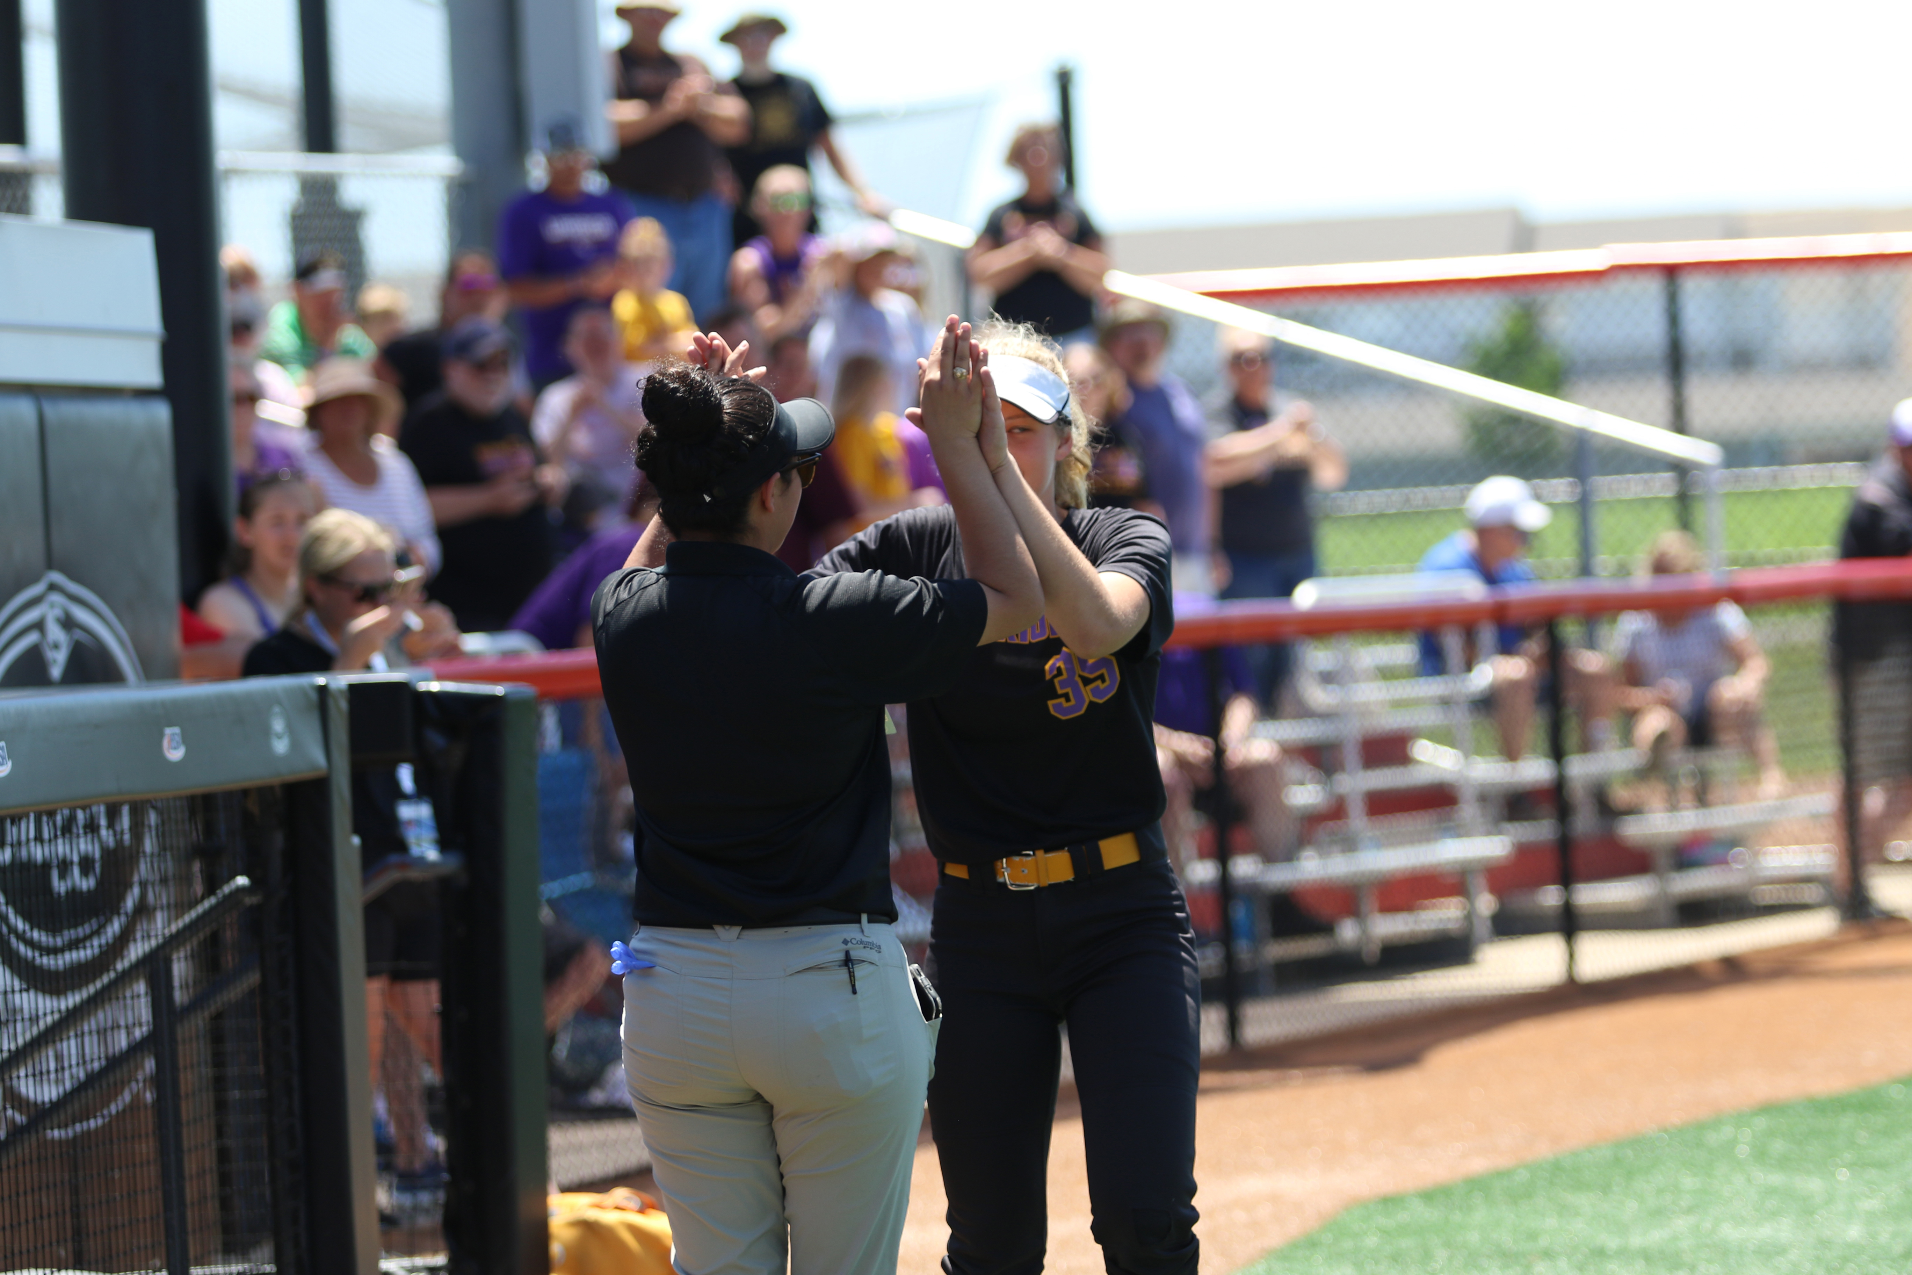
NFHS SOFTBALL RESOURCES
Video Exam Questions
Rules Videos
Softball General Survey
Mid-Season Meetings
Virtual Case Book
Notes:
Video Exam Questions
Rules Videos
Softball General Survey
Mid-Season Meetings
Virtual Case Book

Slide 28
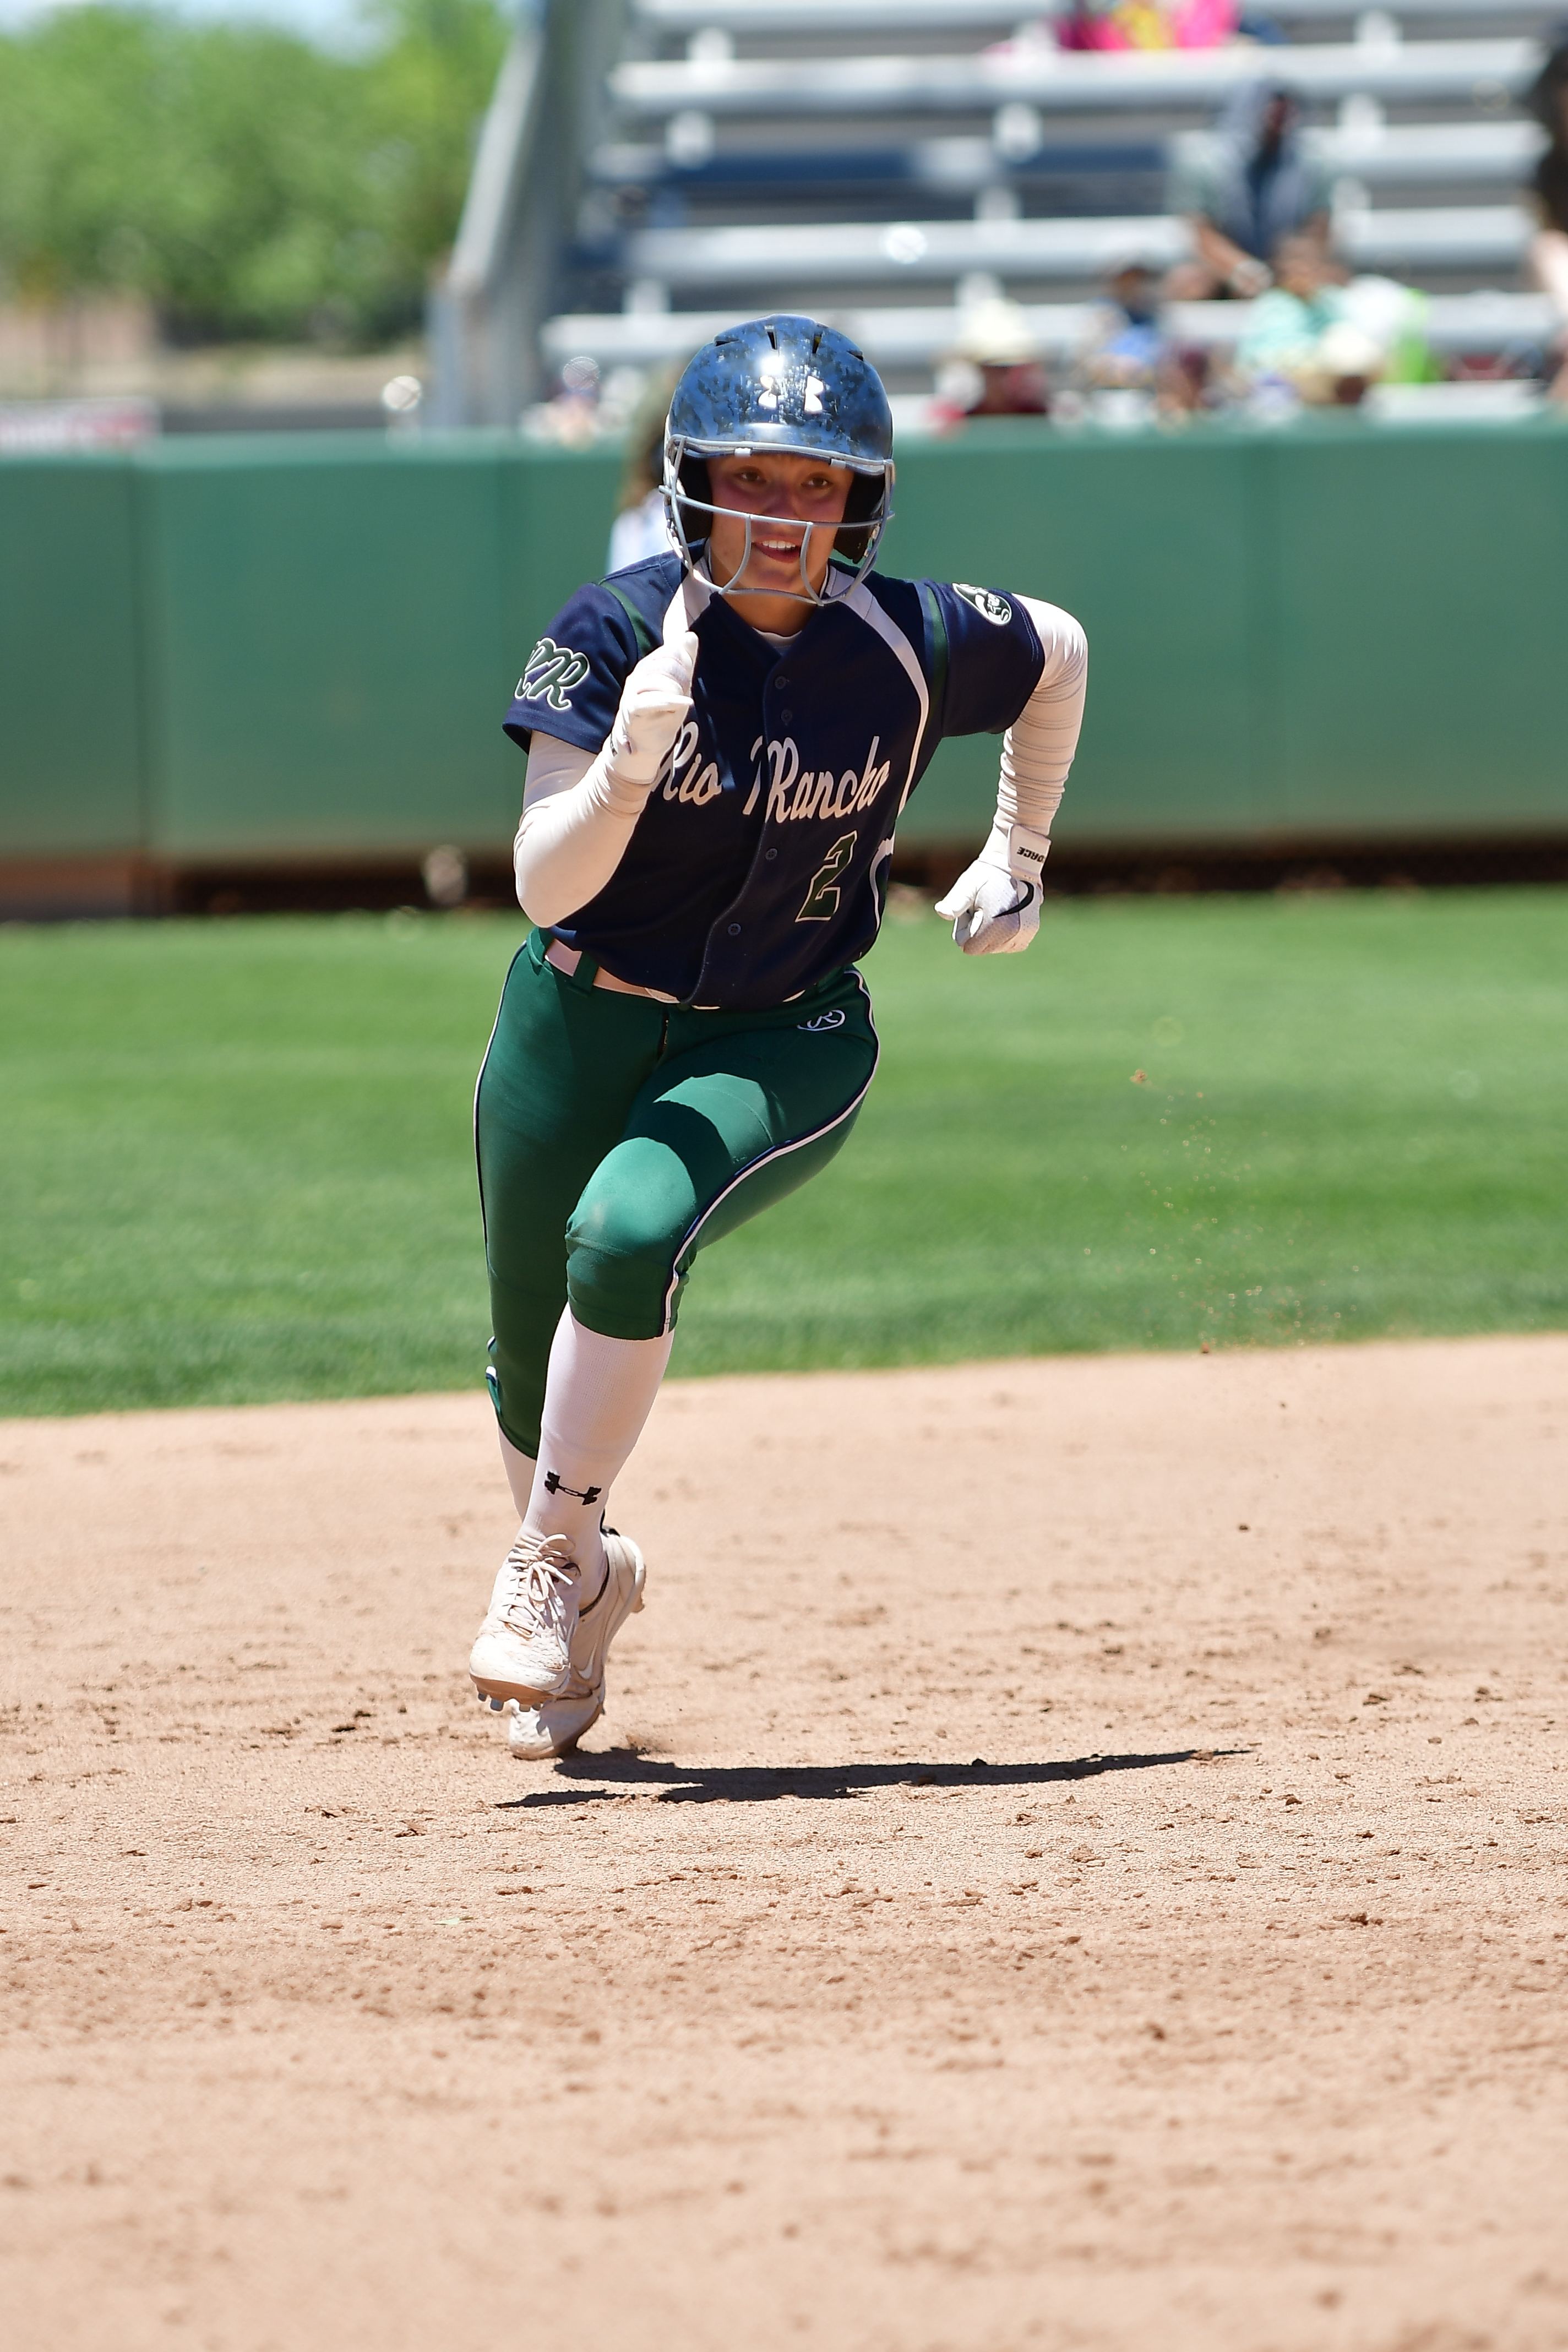
NFHS SOFTBALL RESOURCES
Weekly Rule Interpretations
Softball Pitching Videos
DP/FLEX Strategies for Coaches
PowerPoints for Umpire Training
Illegal Player Penalty Chart
Uniform Rules
Softball Field Diagram
Notes:
Weekly Rule Interpretations
Softball Pitching Videos
DP/FLEX Strategies for Coaches
PowerPoints for Umpire Training
Illegal Player Penalty Chart
Uniform Rules
Softball Field Diagram

Slide 29
Thank You
NFHS.org Phone # 317-822-5735 Email: Ssearcy@nfhs.org

